Slide 1
Supply Chain Management Dashboard
Pavan M R

Slide 2
Index
About Company
Introduction
Software Requirements
Methodology
Result
Conclusion

Slide 3
About Company
Empowering Futures through Knowledge
Utilizing Most Effective Training Methods
Developing Tomorrow's Tech Leaders
uiding Excellence with Unified Mentorship

Slide 4
Introduction
What is Data Science
Data Collection: Gathering data from various sources such as databases, APIs, sensors, or web scraping.
Data Cleaning: Preparing the data by handling missing values, removing duplicates, correcting errors, and normalizing it for analysis.
Data Exploration: Analyzing the data to understand patterns, distributions, and key characteristics through statistical methods.
Data Modeling: Building machine learning models to make predictions, classify data, or find patterns.
Data Visualization: Presenting insights through graphs, charts, dashboards, or reports to make the findings accessible to non-technical stakeholders.

Slide 5
Introduction:
This dataset provides a comprehensive overview of product-related and operational information critical for managing a business's supply chain, sales, and customer insights. It covers various aspects of product lifecycle, from manufacturing to customer delivery.
Product type and SKU: Information identifying the product, with SKU serving as a unique identifier.
Price and Revenue Generated: Price data for each product and the total revenue they have generated, helping to assess profitability.

Slide 6
Availability and Stock Levels: Insights into current inventory levels and product availability.
Number of Products Sold: Details about the quantity of each product sold over a specific period.
Customer Demographics: Information on the customer base, such as age, gender, location, or preferences.
Lead Times and Order Quantities: Tracking the time taken from order placement to delivery and the quantities involved in each transaction.
Shipping Information: Covers shipping times, carriers, costs, and transportation modes to monitor the logistics side of the business.

Slide 7
Supplier and Manufacturing Data: Includes supplier names, locations, production volumes, lead times, and manufacturing costs, offering insights into the supply chain’s efficiency.
Inspection Results and Defect Rates: Tracks quality control measures and defect rates to ensure product quality.
Routes and Transportation Costs: Outlines the transportation routes used and the associated costs, important for logistics and optimizing operations.
Total Sales: A summary column capturing the total sales value for the products.

Slide 8
Requirements
Hardware Requirements
Processor: 2.4 GHz processor
Main Memory: 1 GB
Ram: 1.00GB
Hard Disk: 240 GHz
Software Requirements
Operating System: Windows
MS Excel, SQL

Slide 9
mETHODOLOGY
Data Collection
Data Cleaning and Preprocessing
Data Analysis
Visualization and Reporting
Utilization of Insights:

Slide 10
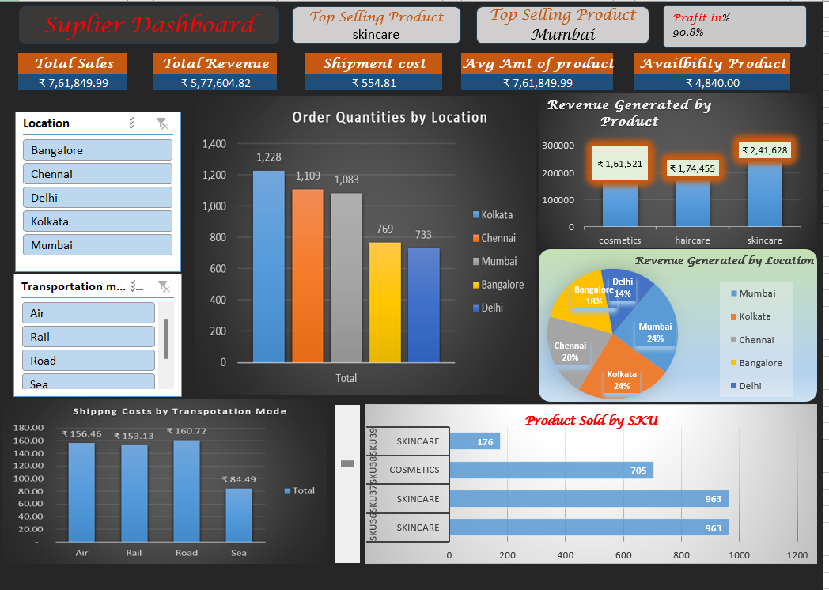
RESULT

Slide 11
conclusion
In conclusion, this data analysis has provided crucial insights into product performance, inventory management, customer demographics, and supply chain efficiency. By leveraging data on sales, stock levels, shipping times, and defect rates, the business can optimize pricing, improve stock availability, target marketing efforts more effectively, and streamline supply chain operations. These insights enable data-driven decisions that enhance overall efficiency, reduce costs, and drive profitability, ensuring better customer satisfaction and long-term business success.

Slide 12
Thank you

